Slide 1
Estimating Surface PM_{2.5} Concentrations using Satellite AOD
Sundar A. Christopher
The University of Alabama in Huntsville
sundar@nsstc.uah.edu
VIIRS Aerosol Science and Operational Users Workshop
November 21-22, 2013
Hoff, R., S.A. Christopher, Remote Sensing of Particulate Matter Air Pollution from Space : Have we reached the promised land?, J. Air & Waste Management Association, 59:642-675, 2009.

Slide 2
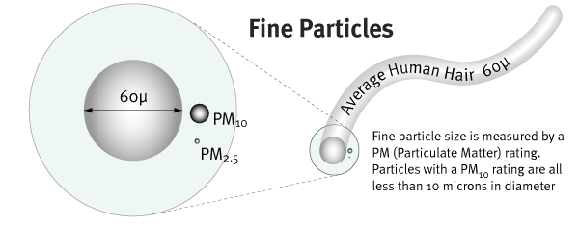
What is PM2.5?
Particles < 2.5µm in diameter – ‘Fine Particles’
All types of combustion – examples : motor vehicles, power plants, forest/agricultural burning,

Slide 3
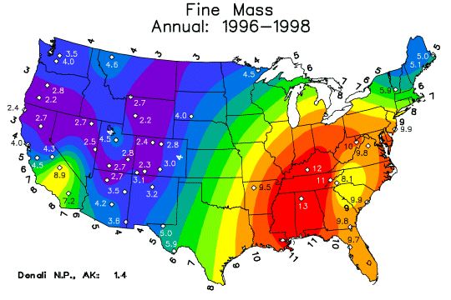
Why study PM2.5?
1996-1998 Fine Mass
Premature Mortality Risk
Huntsville
Alabama
Health studies show link between increased PM2.5 mass and premature mortality.
10 µgm⁻³ increase in PM was associated with 8% to 18% increases in mortality risk [Pope et al., 2003].
Paciorek/ Hu/Al-Hamdan

Slide 4
U.S. Air Quality Guidelines
Index
Values
Category
Cautionary Statements
PM_{2.5}
(ug/m³)
PM₁₀
(ug/m³)
0-50
Good
None
0-15.4
0-54
51-100
Moderate
Unusually sensitive people should consider reducing prolonged or heavy exertion
15.5-40.4
55-154
NAAQS: 35 μg/m³ (24 h), 15 μg/m³ (annual)
101-150
Unhealthy for Sensitive Groups
Sensitive groups should reduce prolonged or heavy exertion
40.5-65.4
155-254
151-200
Unhealthy
Sensitive groups should avoid prolonged or heavy exertion; everyone else should reduce prolonged or heavy exertion
65.5-150.4
255-354
201-300
Very Unhealthy
Sensitive groups should avoid all physical activity outdoors; everyone else should avoid prolonged or heavy exertion
150.5-250.4
355-424

Slide 5
WHO - Guidelines
 | 24-Hour Av PM_{2.5} (μgm⁻³) | Basis for the selected level | Annual Average PM_{2.5} (μg m⁻³) | Basis for the selected level
Interim Target-1 (IT-1) | 75 | Based on published risk coefficients from multi-centre studies and meta-analyses (~ 5% increase of short-term mortality over the AQG value). | 35 | These levels are associated with about a 15% higher long-term mortality risk relative to the AQG level.
Interim Target-2 (IT-2) | 50 | Based on published risk coefficients from multi-centre studies and meta-analyses (about 2.5% increase of short-term mortality over the AQG value). | 25 | In addition to other health benefits, these levels lower the risk of premature mortality by approximately 6% [2–11%] relative to the IT-1 level.
Interim Target-3 (IT-3) | 37.5 | Based on published risk coefficients from multi-centre stud­ies and meta-analyses (about 1.2% increase in short-term mortality over the AQG value). | 15 | In addition to other health benefits, these levels reduce the mortality risk by approximately 6% [2-11%] relative to the IT-2 level.
Air Quality Guideline (AQG) | 25 | Based on the relationship between 24-hour and annual PM_{2.5} levels. | 10 | These are the lowest levels at which total, cardiopul­monary and lung cancer mortality have been shown to increase with more than 95% confidence in response to long-term exposure to PM_{2.5}
NAAQS: 35 μg/m³ (24 h), 15 μg/m³ (annual)

Slide 6

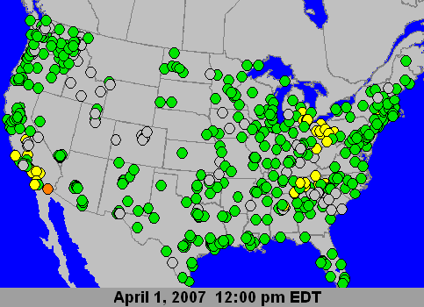
Surface PM_{2.5} mass monitors
1500
0-3
20-30
3-8
5-10
1-5
1-5
4-9
Number of Ground measurements are sparse and inadequate for monitoring global PM2.5 mass concentrations – especially outside the United States

Slide 7
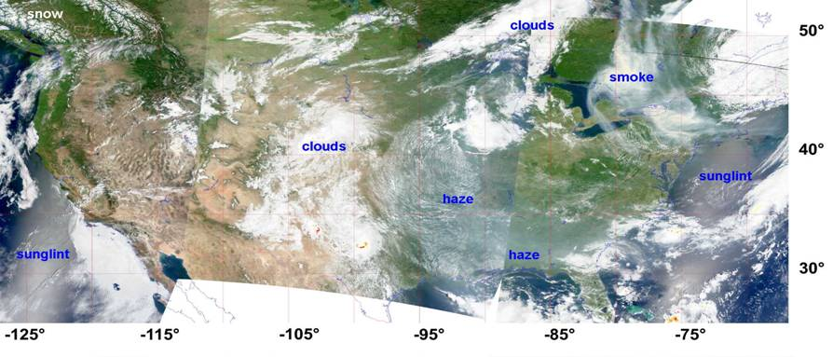
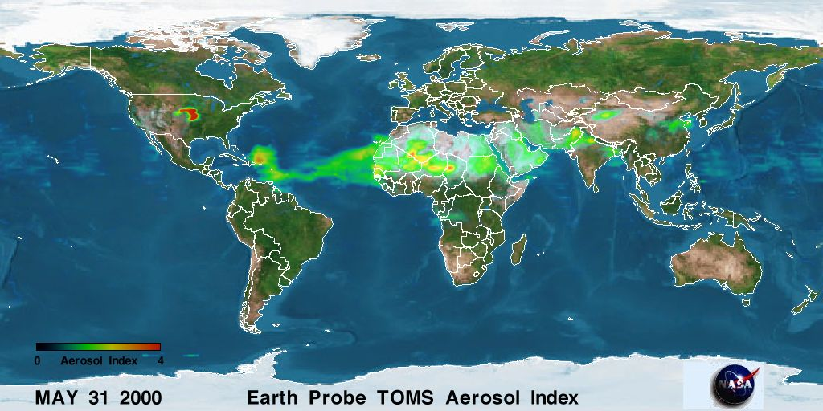
Satellite Remote Sensing
SNOW
CLOUDS
SMOKE
GLINT
HAZE
GLINT
Engel-Cox
Satellites remote sensing is the only viable method for monitoring global particulate matter air pollution

Slide 8
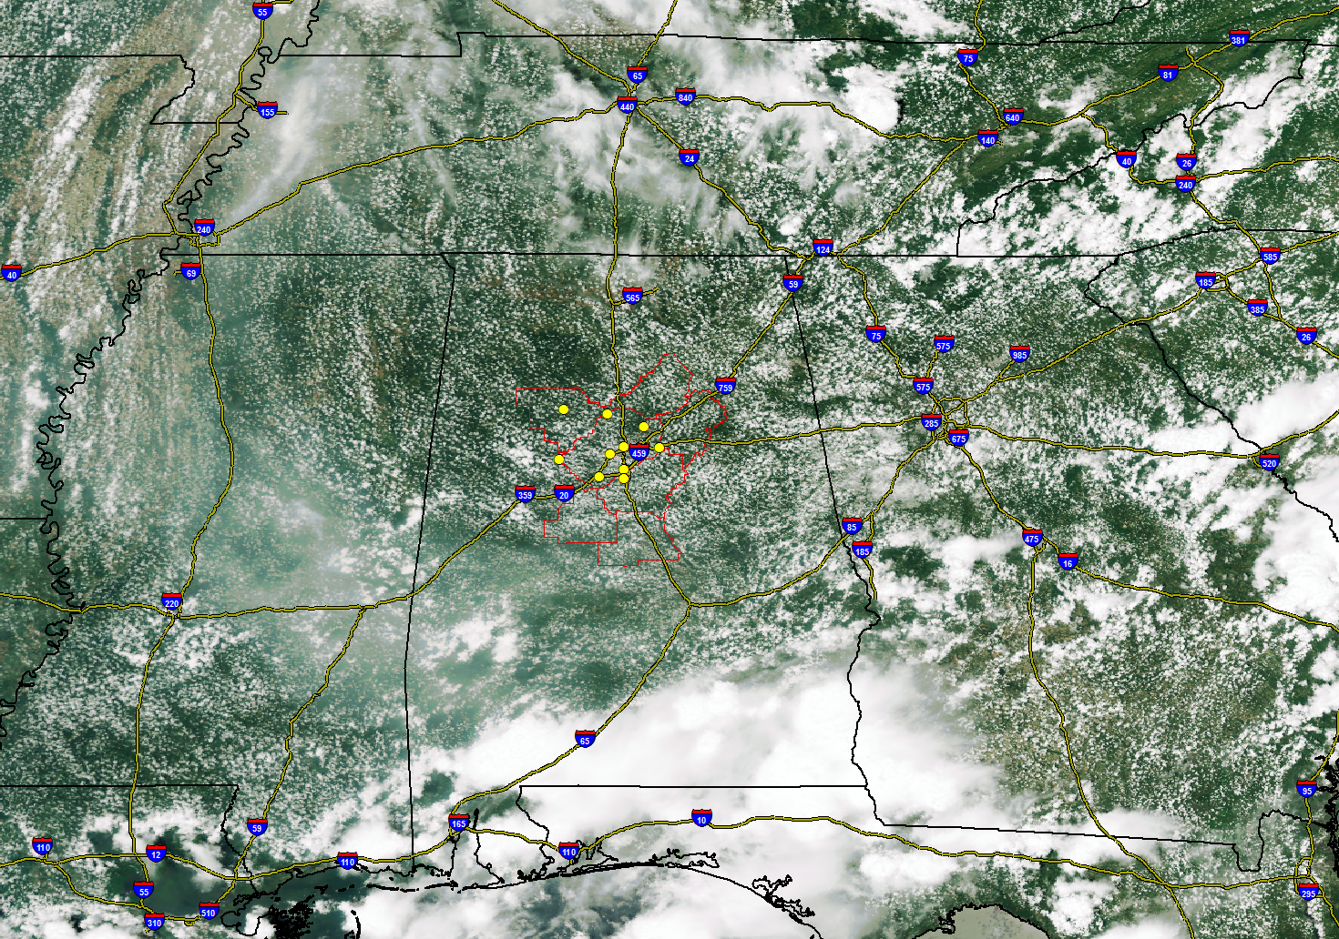
VIIRS Example
Aerosol
Birmingham
Alabama

Slide 9
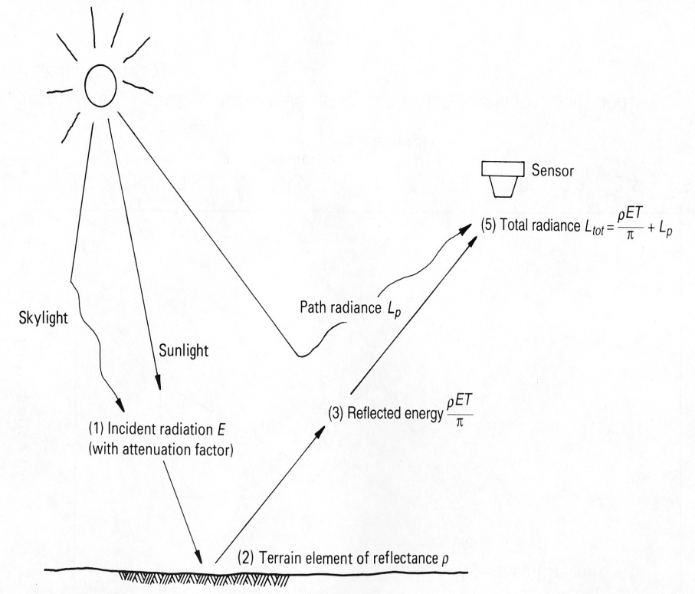
But what do satellites measure?
Need surface PM2.5
Have column AOD
AOD is related to PM2.5 but need ancillary information
Satellite measured radiances
are converted to columnar
Aerosol Optical Thickness/Depth

Slide 10
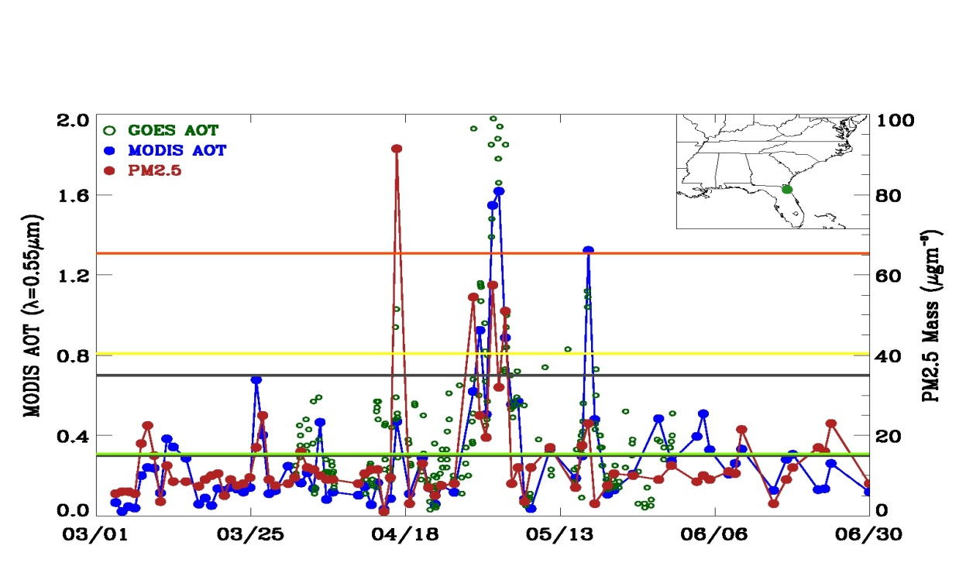
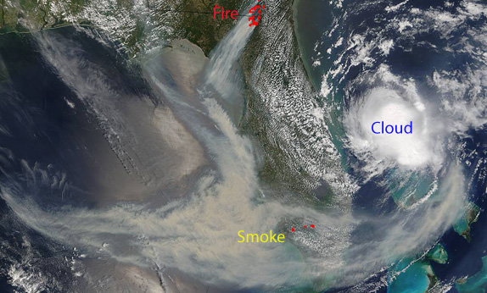
Satellite and ground-based data
Both Level 1 RGB imagery and level 2 aerosol product information is useful
Christopher, S.A., P. Gupta, U. Nair, T.A. Jones, S. Kondragunta, Y. Wu, J. Hand, X. Zhang, Satellite Remote Sensing and Mesoscale Modeling of the 2007 Florida/Georgia Fires, IEEE Journal of Selected Topics in Applied Earth Observations and Remote Sensing (JSTARS-2009-00020), 26, 1-13, 2009

Slide 11
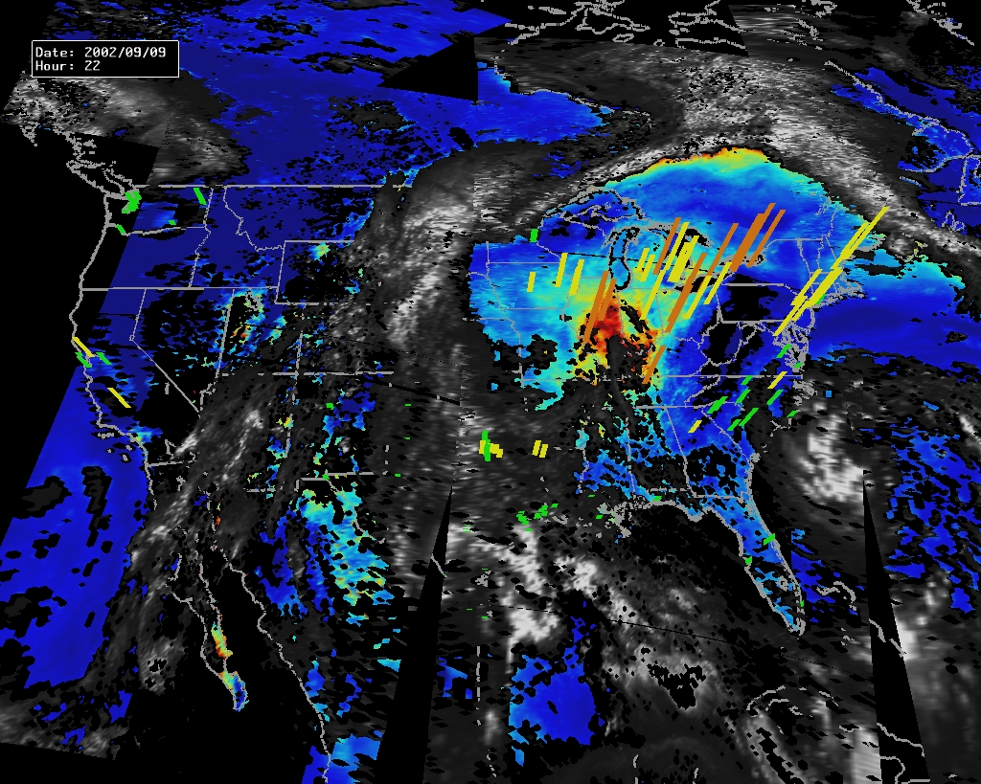
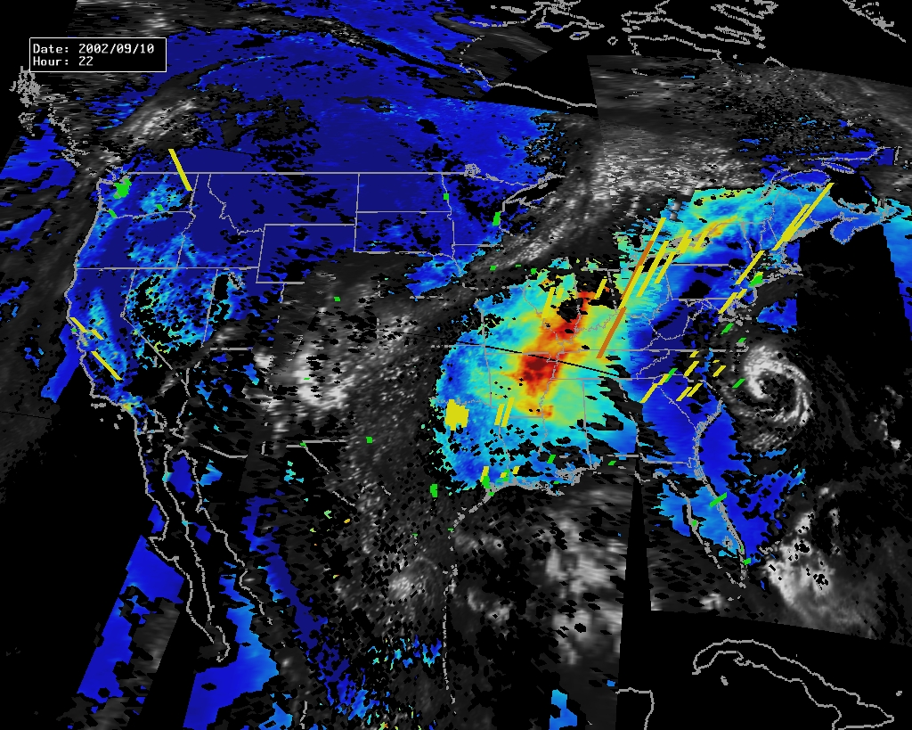
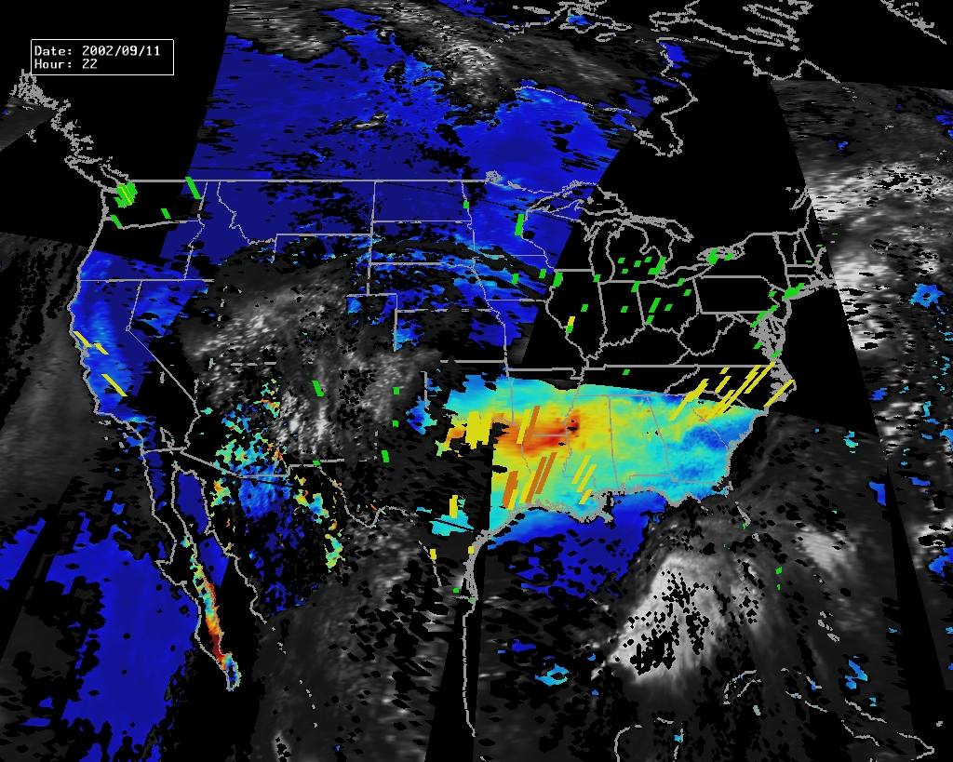
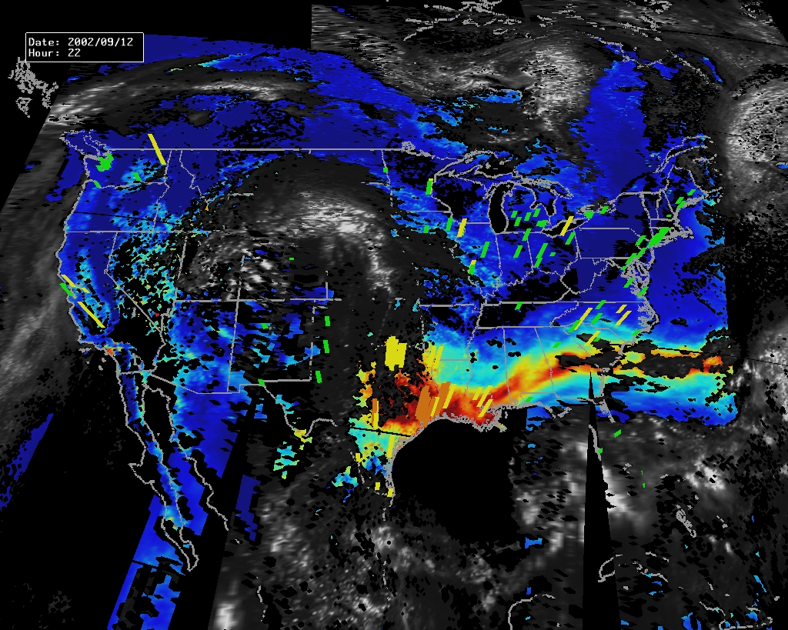
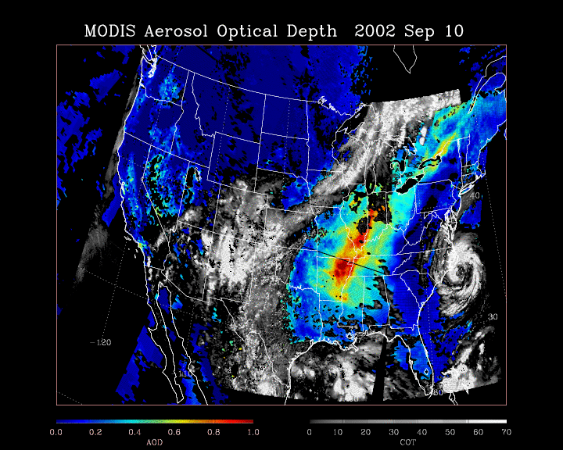
Sept 9
Sept 10
No EPA sites
MODIS fills in
Sept 11
Sept 12
0.0 0.2 0.4 0.6 0.8 1.0 0 10 20 30 40 50 60 70 0 15.5 40.5 65.5 150.5
Aerosol Optical Depth Cloud Optical Thickness PM2.5 (ug/m3)
Notes:
The IDEA project
Training (EPA, National Air Quality Conference, AWMA, United Nations)

Slide 12
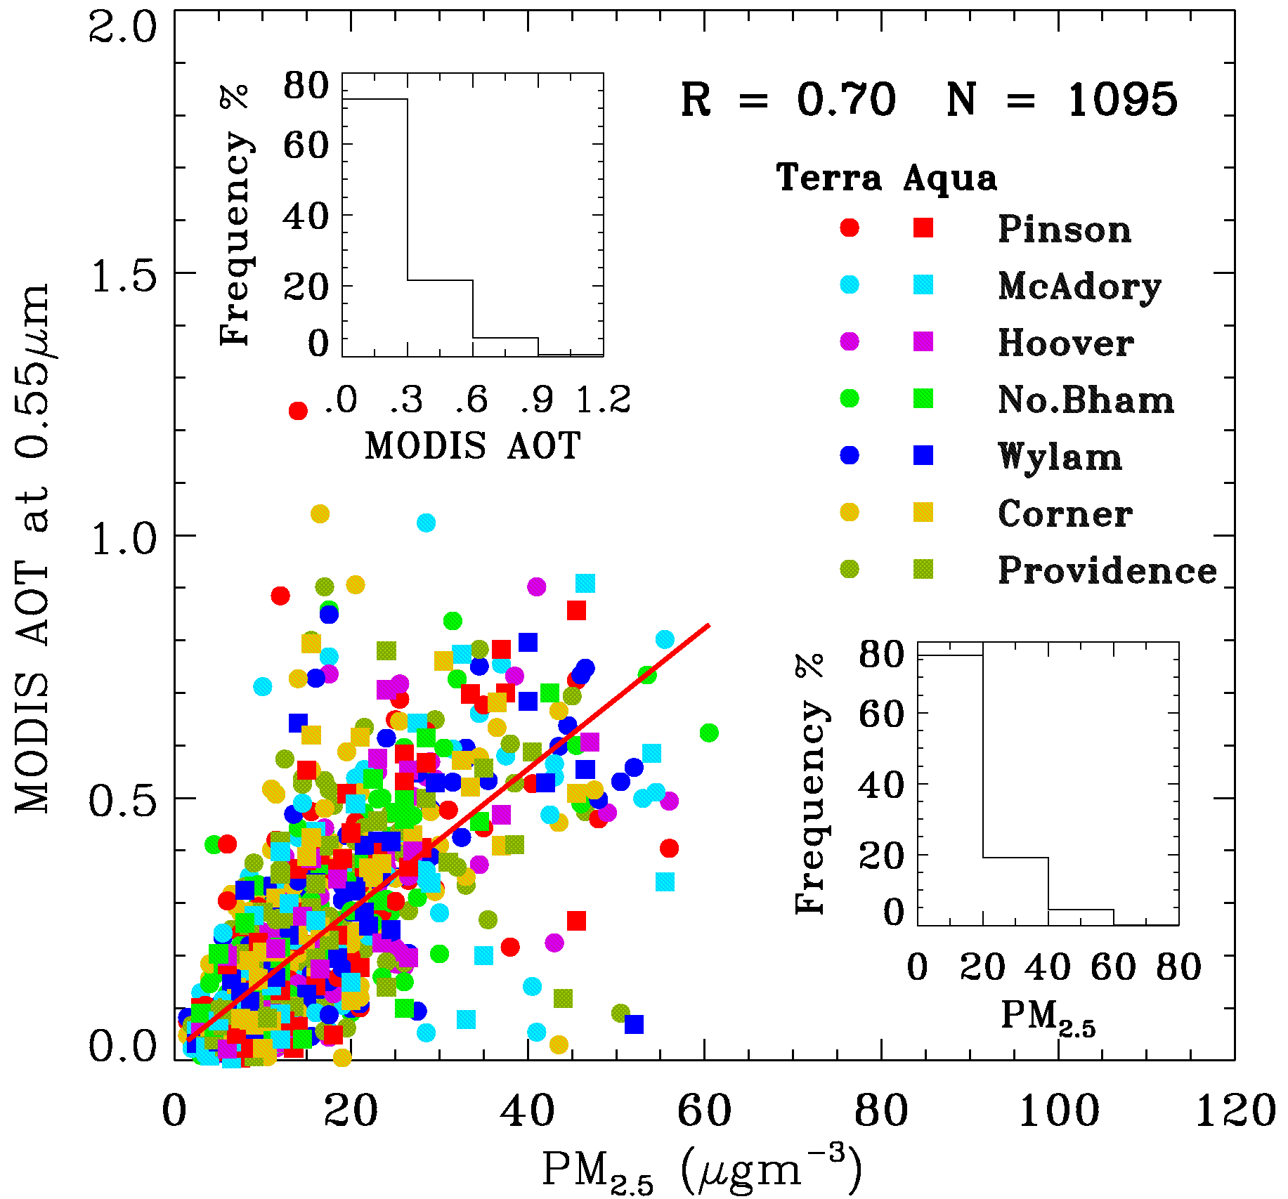
Correlating PM2.5 and AOD
For the easy (relatively) cases if there is a PM-AOD relationship (linear in this case) use AOD to estimate PM2.5
Wang and Christopher, 2003
Hourly, R= 0.7;Daily, R >0.9
Wang, J., and S. A. Christopher, Intercomparison between satellite-derived aerosol optical thickness and PM2.5 mass: Implications for air quality studies, Geophys. Res. Lett., 30(21), 2095, doi:10.1029/2003GL018174, 2003

Slide 13
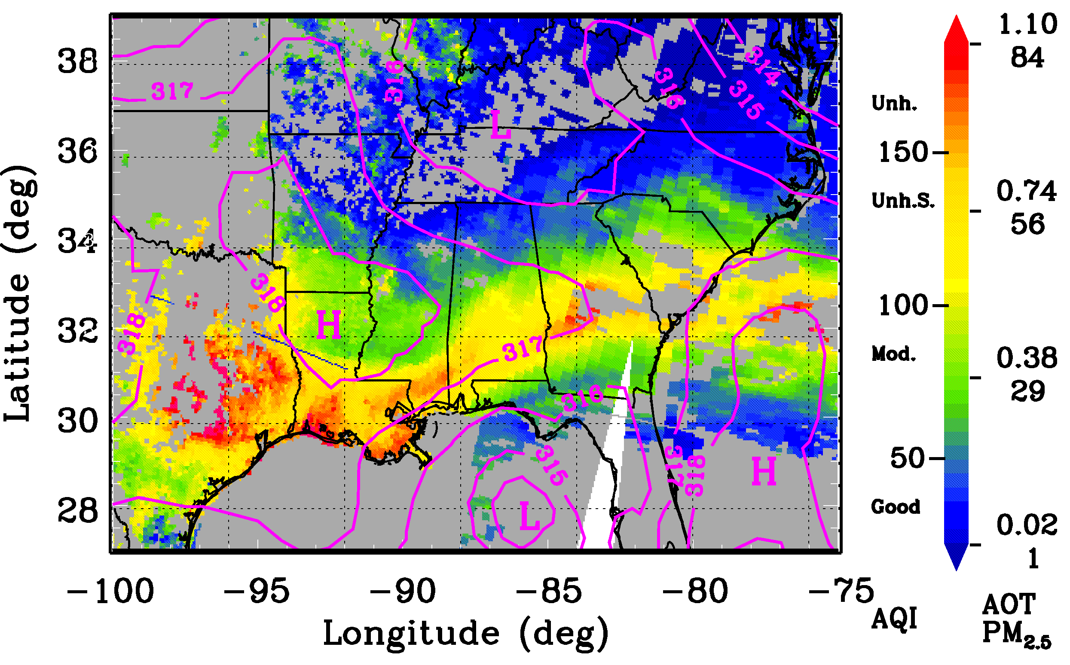
Creating AQI maps
Every pixel that is not cloud covered has an AQI value

Slide 14
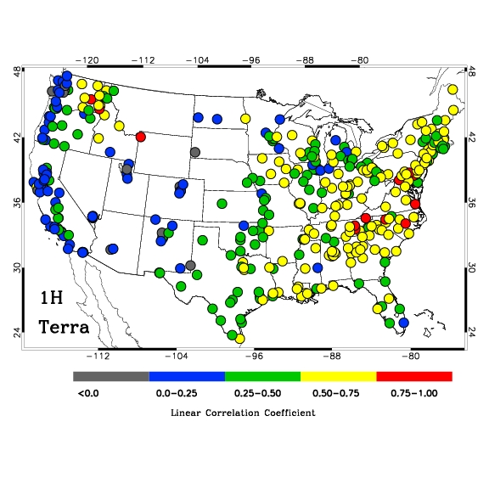
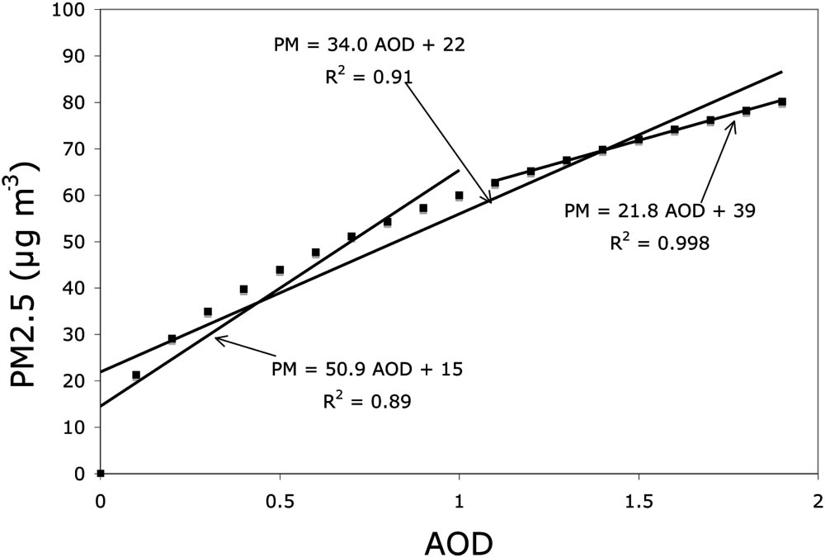
Uncertainties
PM2.5 /AOD varies across studies due to different assumptions.
Uncertainty
Linear Correlation Coefficient
Even though clouds prevent AOD retrievals ~50% of the time, difference between ALL
PM2.5 from ground and PM2.5 during time of satellite overpass is < 2ugm⁻³ for
seasonal and yearly averages (Christopher and Gupta, 2009).
Notes:
Reasons include
Surface reflectance is higher in the West than the East
Predominantly sulfate type of aerosols in the East when compared to Nitrate type of aerosols in the West
Different meteorology and PBL heights

Slide 15
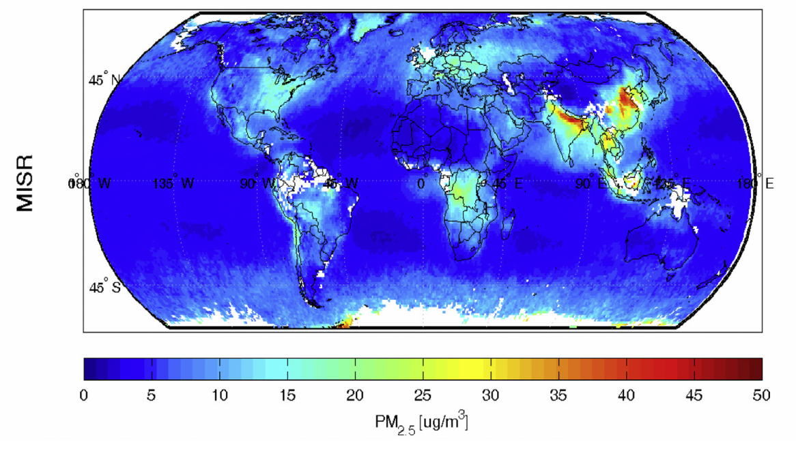
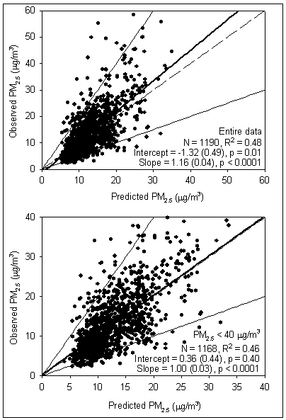
Beyond the linear correlation
Van Donkelaar, et al 2006
Liu et al (2005)
Observed PM2.5
Predicted PM2.5
Aircraft studies also show that normalizing AOD with PBL height significantly improves AOD-PM2.5 relationship (Al-Saadi)
PBL, RH are necessary to estimate PM2.5 from columnar satellite retrievals. Correlations increase from 0.3 to 0.7.

Slide 16
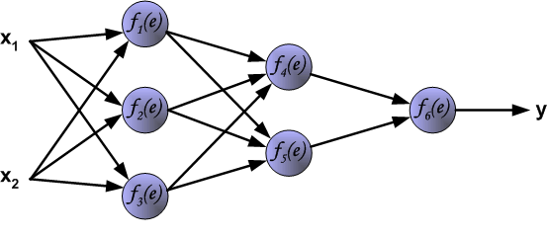
Progress
PM2.5 Estimation from Satellite Observations (MODIS, MISR, GOES, POLDER)
Two variate methods
Multi-variate methods
Neural Networks
MVM
Y=mX + c
PM2.5=α+ α1*AOT+ α2*TMP+ α3*HPBL+ α3*WS+ α4*RH
PM2.5
AOT
Few
TWO?
THREE
Dozen +
Global
Estimates
POLDER
MODIS
MISR
Lidar
SeaWifs
GOES
Epidemiology
1984
2000
2002
2003
2004
2005
2006
2007
2008
2009
2013
Fraser&
Kaufman
Terra
Aqua
1st
paper
BAMS
Review
Critical
Review
Global
VIIRS

Slide 17
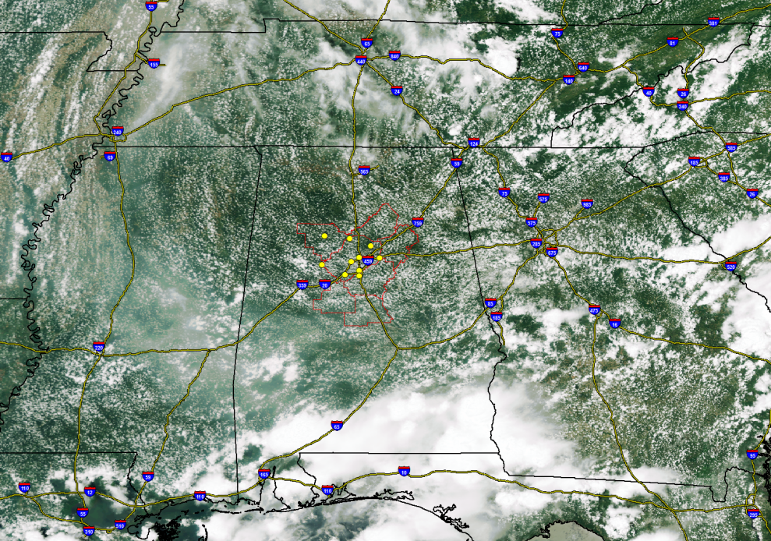
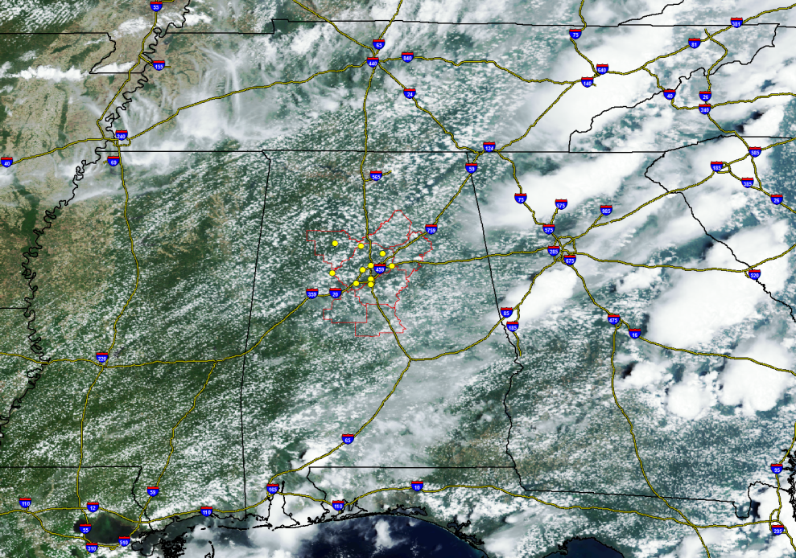
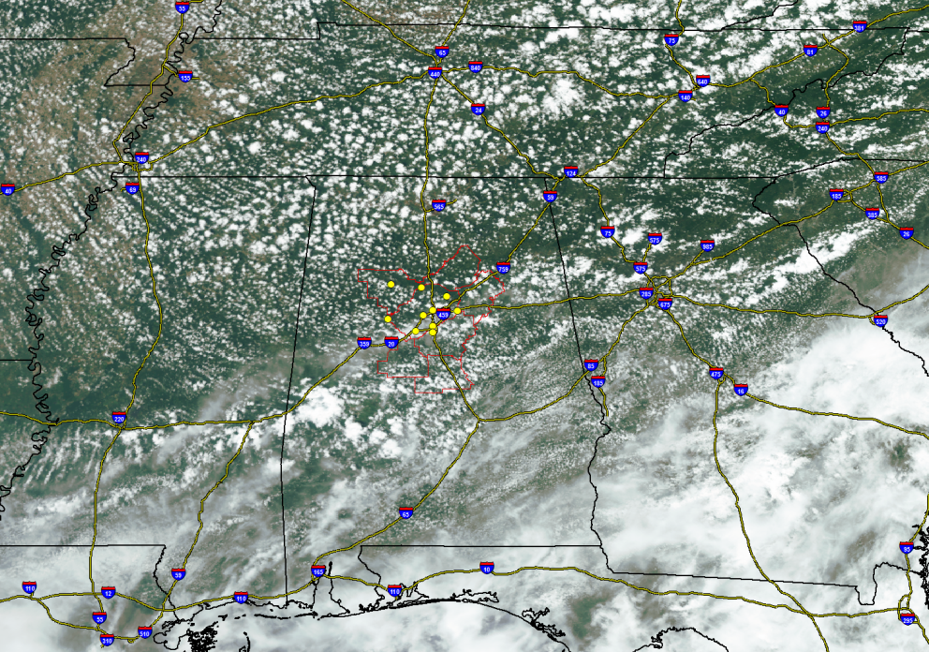
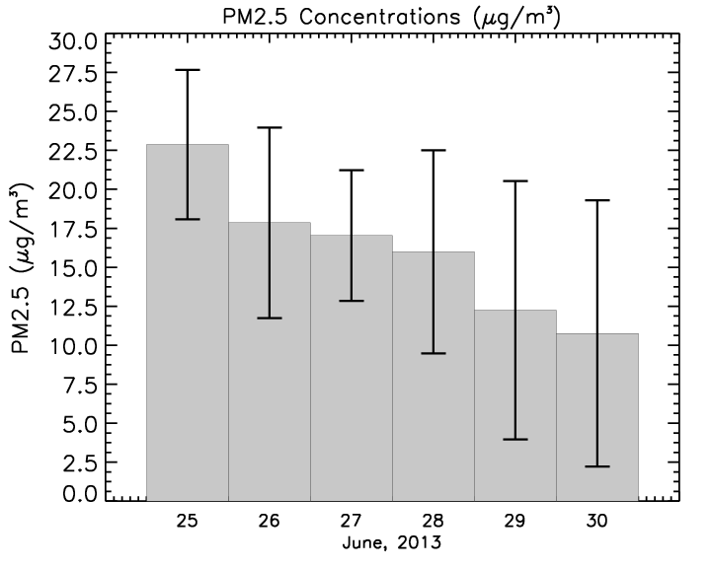
VIIRS Examples
June 23, 2013
June 26, 2013
June 29, 2013

Slide 18
Summary
Satellite data continue to be useful to monitor air pollution
With ancillary data sets, satellite AOD can be used to estimate PM2.5 concentrations across the earth. Especially useful where no ground monitors are available
Awareness in other communities (e.g. epidemiology) continues to increase

